Slide 1

PIE Chart
Group 4

Slide 2
The “pie chart” is also known as a “circle chart”, dividing the circular statistical graphic into sectors or sections to illustrate the numerical problems. Each sector denotes a proportionate part of the whole.
It contains different segments and sectors in which each segment and sector of a pie chart forms a specific portion of the total(percentage). The sum of all the data is equal to 360°.
The total value of the pie is always 100%.

Slide 3
Syntax and parameters
Syntax: matplotlib.pyplot.pie(data, explode=None, labels=None, colors=None, autopct=None, shadow=False) Parameters: data represents the array of data values to be plotted, the fractional area of each slice is represented by data/sum(data). If sum(data)<1, then the data values returns the fractional area directly, thus resulting pie will have empty wedge of size 1-sum(data). labels is a list of sequence of strings which sets the label of each wedge. color attribute is used to provide color to the wedges. autopct is a string used to label the wedge with their numerical value. shadow is used to create shadow of wedge.

Slide 4
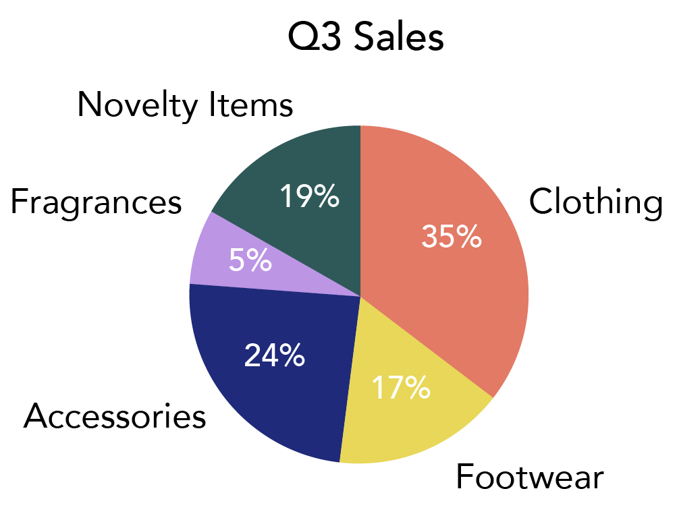
Advantages of using Pie charts
THESE CHARTS ARE WAY SIMPLER THAN OTHER FORMS OF CHARTS.
PIE CHARTS ARE A GOOD WAY TO REPRESENT LARGE DATA IN A SIMPLE GRAPHICAL MANNER.
Pie charts ARE MOSTLY USED WHEN DEALING WITH GROUPED DATA
THESE CHARTS PREFERRED DURING PRESENTATIONS IN SCHOOLS, OFFICES ETC
WHEN NUMBER OF RECORDED INFORMATION IS LESS THAN 6 AND CHANGE IN DATA NEED NOT TO BE ADDRESSED, A PIE CHART IS APT
This Photo by Unknown author is licensed under CC BY.

Slide 5
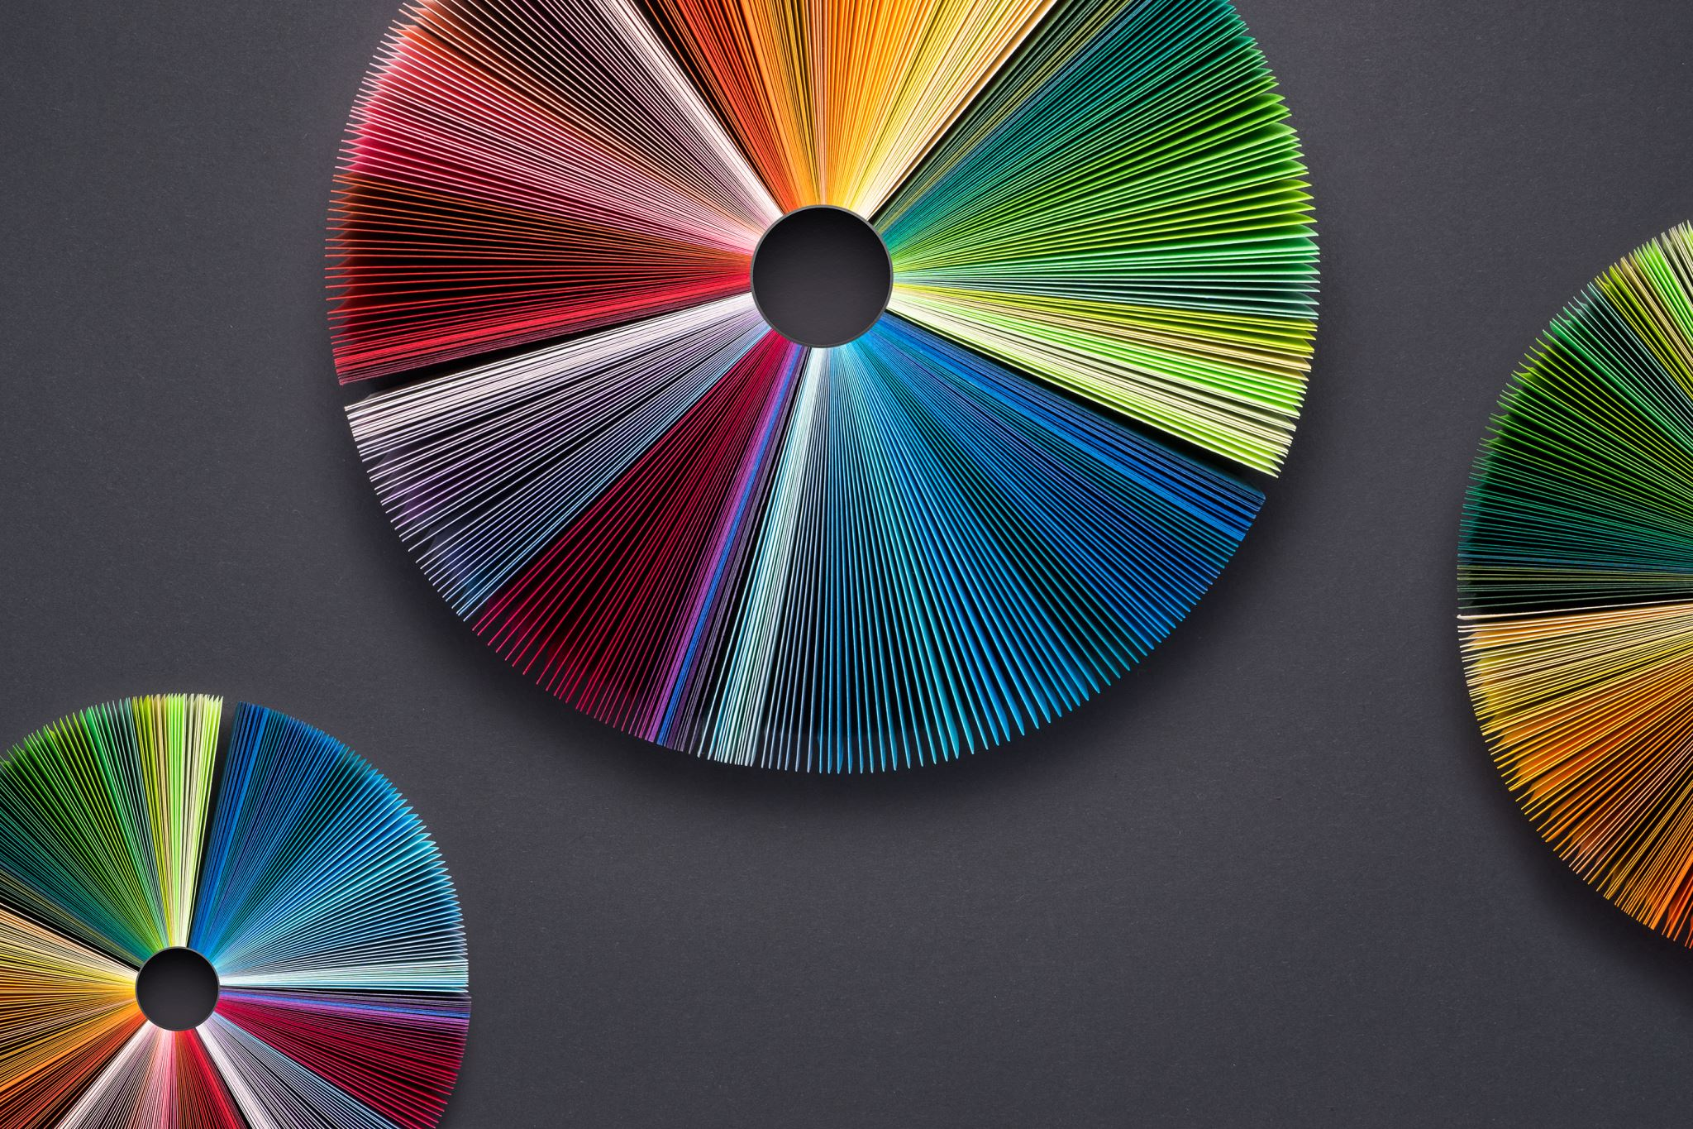
Disadvantages of using Pie charts
Pie charts don’t work well with data with categories having similar values. This is because when we divide the data into many slices, the similarity between them makes it hard to distinguish them and the diversity between them is not properly conveyed.
The more the number of categories increase, the more the number of the slices increase and the more complex the chart becomes to read. This makes pie charts unsuitable for large data.
It takes up more space than any other suitable alternatives to represent data.
They are not preferred when making an accurate comparison between groups.
Pie charts do not give you the exact values of data. It is a mere summation of data in parts to the whole.

Slide 6
TYPES OF PIE CHARTS
3D-PIE CHART
DOUGHNUT PIE CHART
EXPLODED PIE CHART
SUNBURST PIE CHART

Slide 7
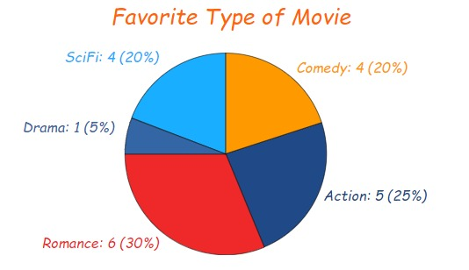
For example, if you take a survey of the movies your friends or colleagues like and record it in a tabular form, it can be represented by a pie chart as illustrated above.

